Slide 1

The Technology that Changed the World:
How Technology Impacts People in the United States, Both Negatively and Positively
Group Members:
Matthew Bartley, Justin Butler, Chloe Collins, Patrick Glover, Timisha Martin, Sonal Panchal, George Pasley, Anna Phimmasone, Mohammad Sami, Jason Tan

Slide 2
Project Hypothesis:
The growth of technology in the 21st century, including social media, cell phones and video games, has radically impacted people of all ages in the United States both positively and negatively.
How has technology impacted:
…the obesity rate in young people?
…education in American youth?
…the overall crime rate?
…the employment rate in America?
…outdoor activity and sports participation among young people?

Slide 3
Why We Asked the Questions We Asked:
We chose to ask our questions for various reasons:
Some of us, as parents, are very interested in the impact technology has on children and teens.
We all, as students of data analytics, are interested in technology’s impact on the employment rate.
We all, as citizens of this country and state, are interested in the impact technology has on the crime rate.

Slide 4
Difficulties
we wanted to find research for a specific demographic.
Trying to find:
how overall technology has an impact on teenagers
information about teenagers, cyberbullying, and their use with social media
Difficult finding datasets containing any kind of information with minors and young adults
cyberbullying
social media
accounts like Facebook
Some of the websites that provided datasets required a subscription or we had to pay to get the information.

Slide 5
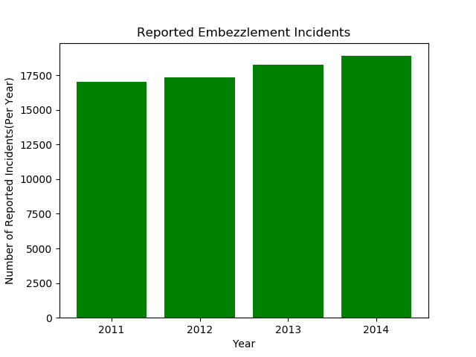
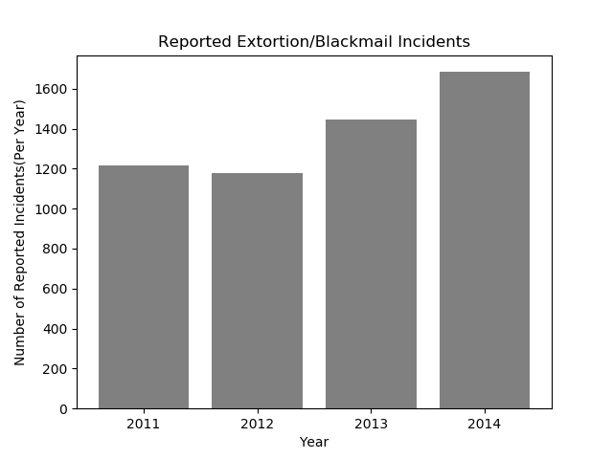
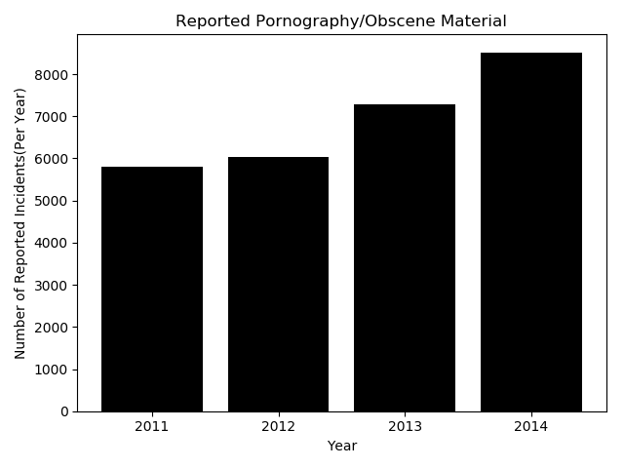
Technology’s impact on the crime rate:

Slide 6
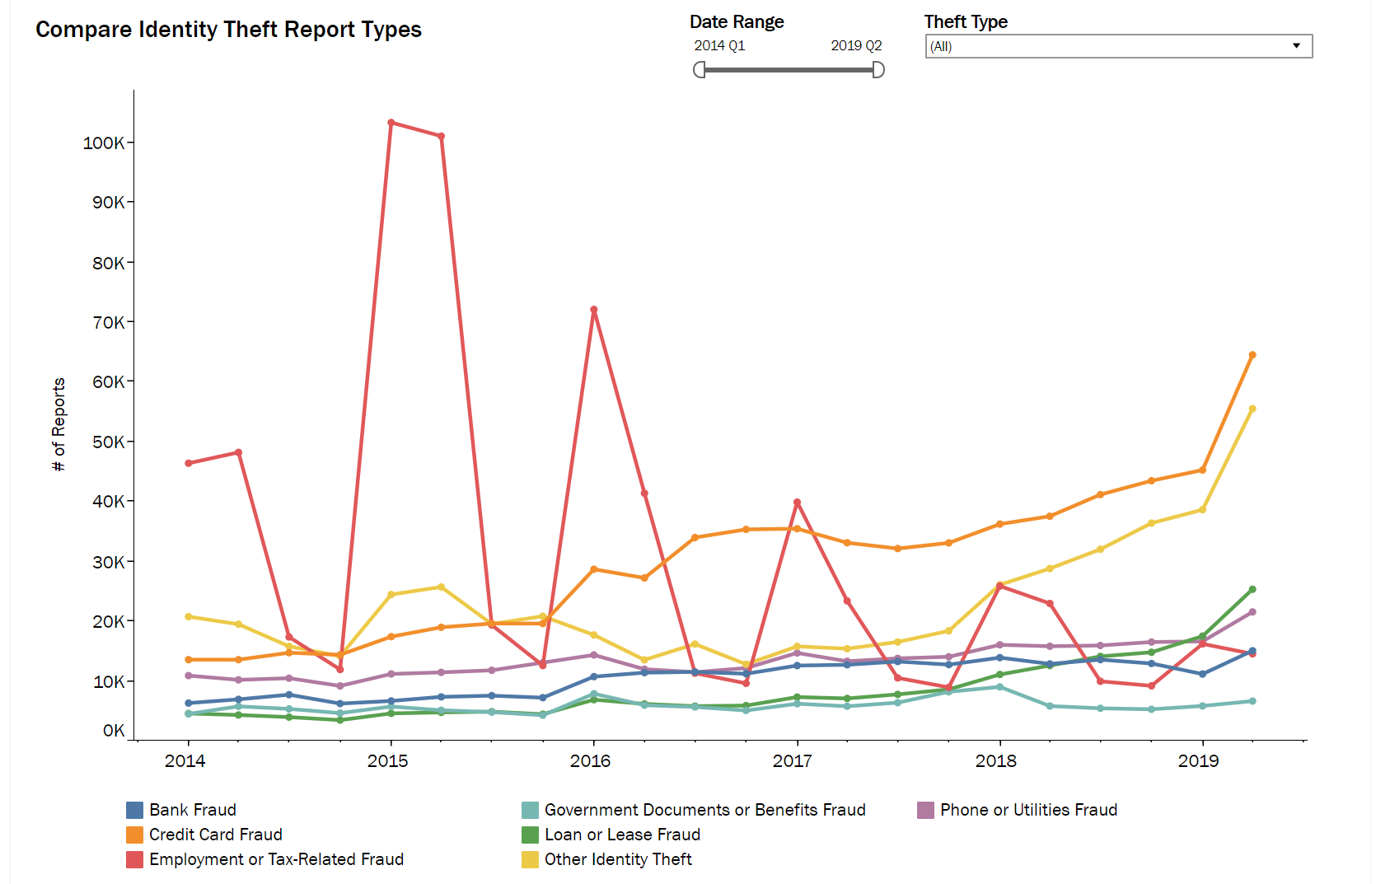
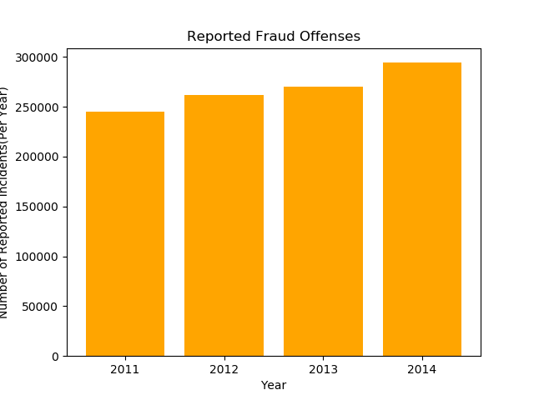
FRAUD OFFENSES

Slide 7
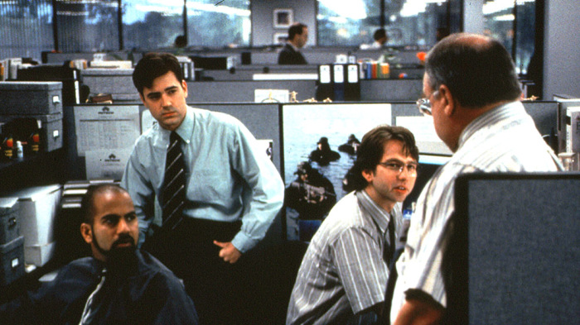
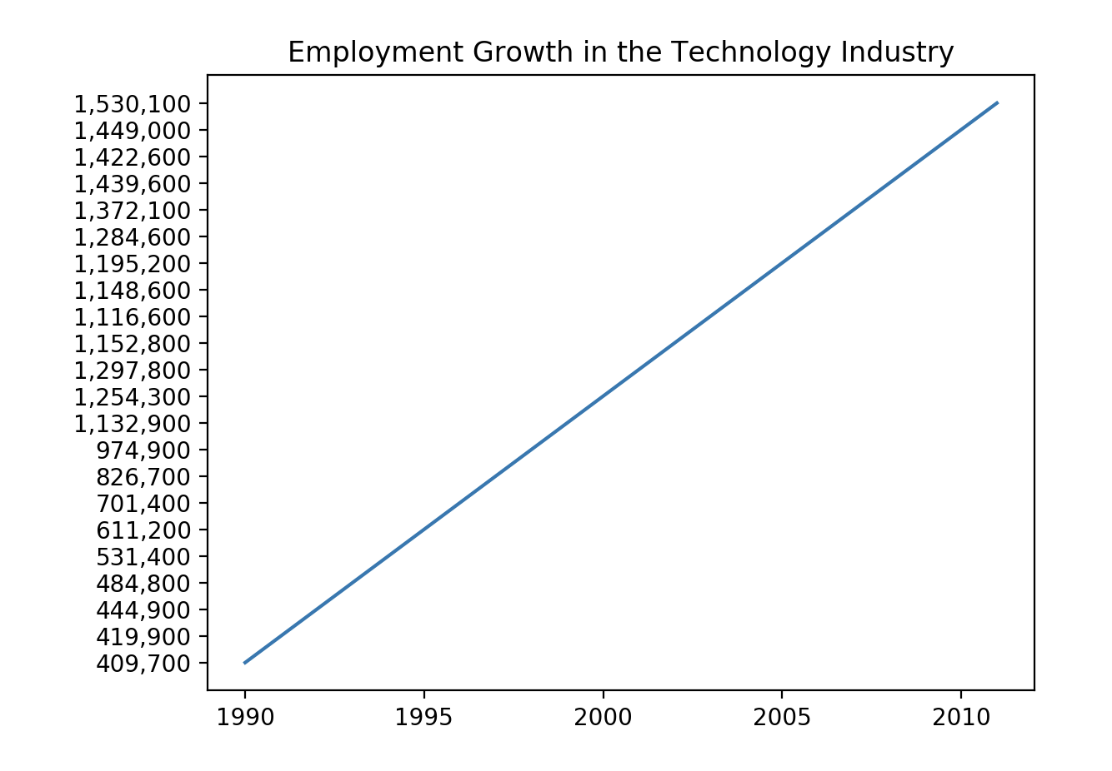
Technology’s impact employment:

Slide 8
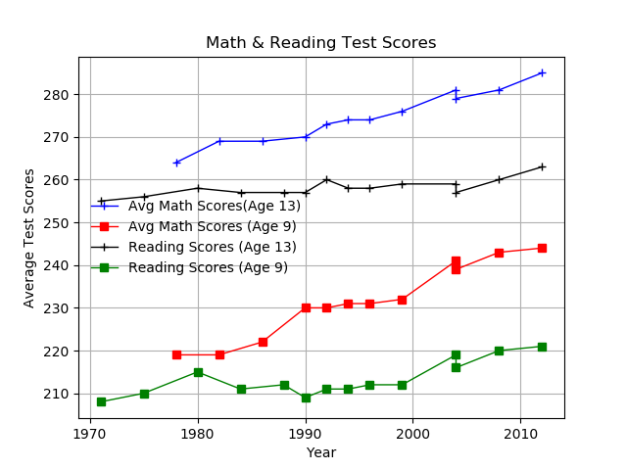

Technology’s impact on education:

Slide 9
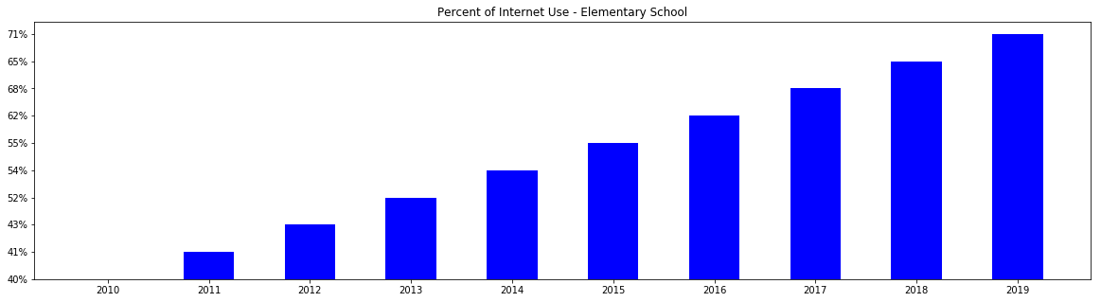
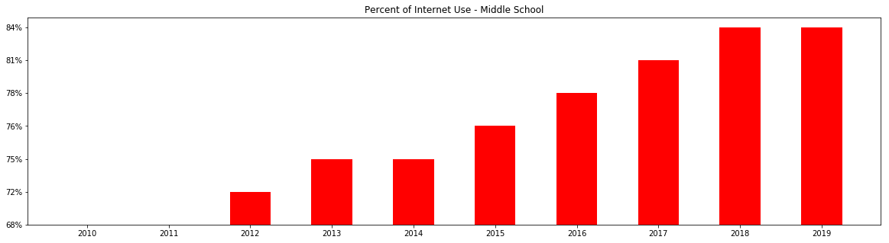
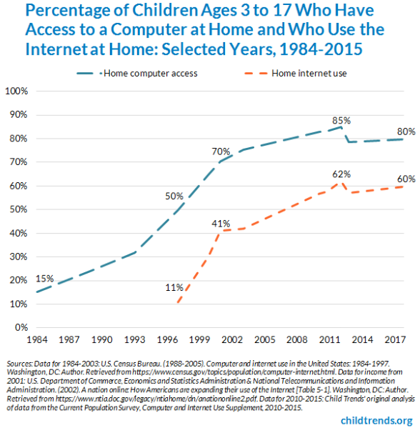
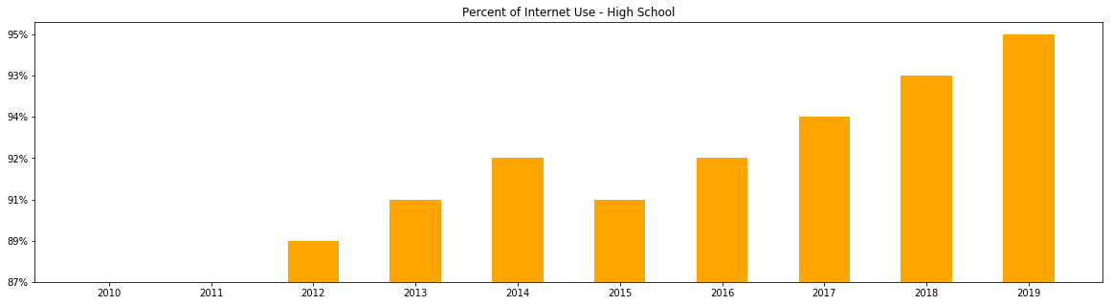
…Education continued
Computer and internet access at home from 1984 to 2015

Slide 10

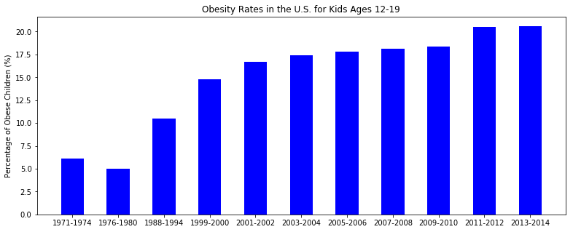
Technology’s impact on young people:

Slide 11
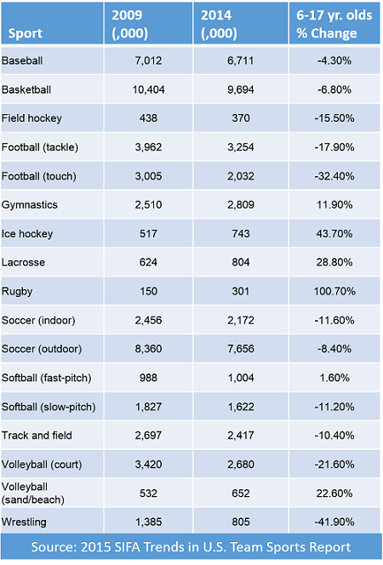
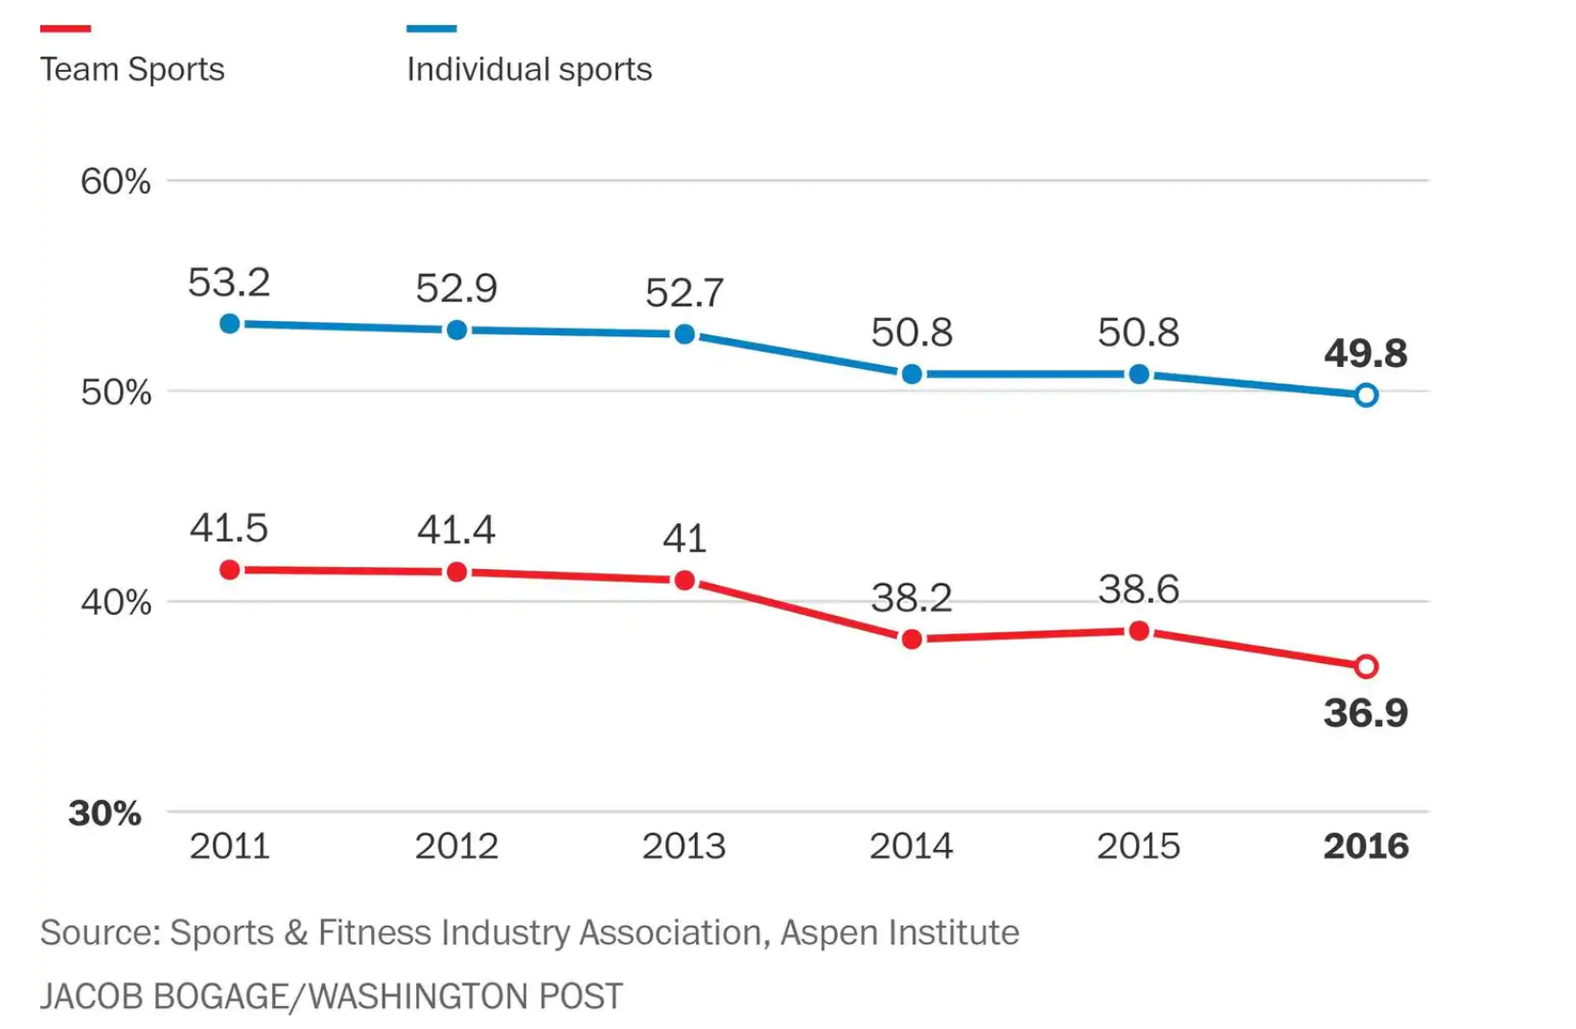

Technology’s impact on sports participation:

Slide 12
Internet Usage & Social Media Usage
Dataset facts: Sample size is 102,400 surveys over the course of 19 years.
Every year, roughly 40,000 questionnaires were distributed, about 10,000 replies, and only 4-5,000 are usable.
Observation: Mostly usage spiked around 2010-2011, gradually increase until 2018.
Source: “pew research center”. Dataset is in csv format. Graphs plotted using matplotlib.

Slide 13
WORK CITED
Crime Related Slide (Extortion, Embezzlement, Obscene Material, and Fraud Offenses:
https://ucr.fbi.gov/nibrs/2011/data-tables
FTC Fraud Reports:
https://public.tableau.com/profile/federal.trade.commission#!/vizhome/IdentityTheftReports/TheftTypesOverTime
https://public.tableau.com/profile/federal.trade.commission#!/vizhome/TheBigViewAllSentinelReports/TopReports
Obesity Rates:
https://data.world/login?next=%2Fhealth%2Fchildhood-obesity-in-the-us%2Fworkspace%2Ffile%3Ffilename%3Dobesity_child_age.csv

